Slide 1
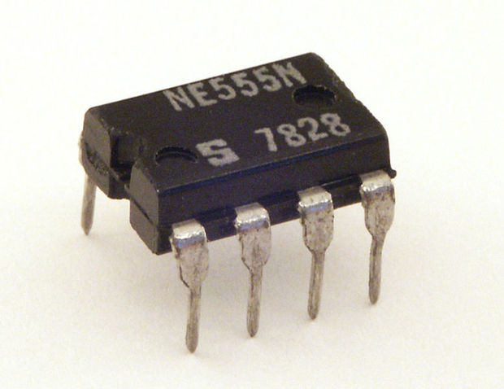
555 Timer

Slide 2
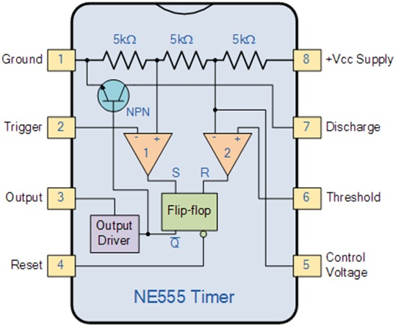
Internal Block diagram

Slide 3
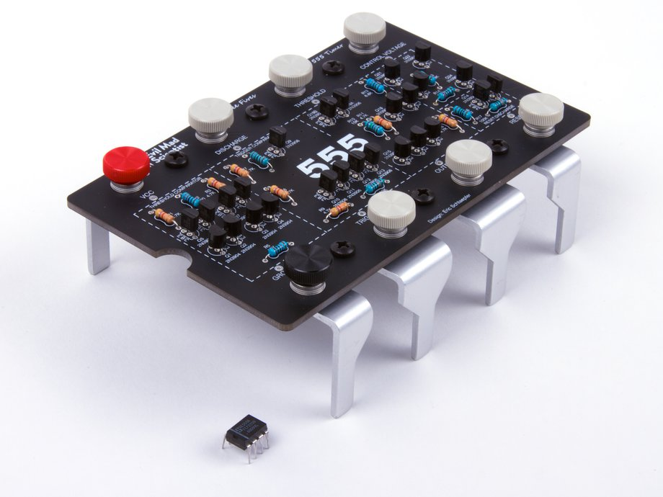

Slide 4
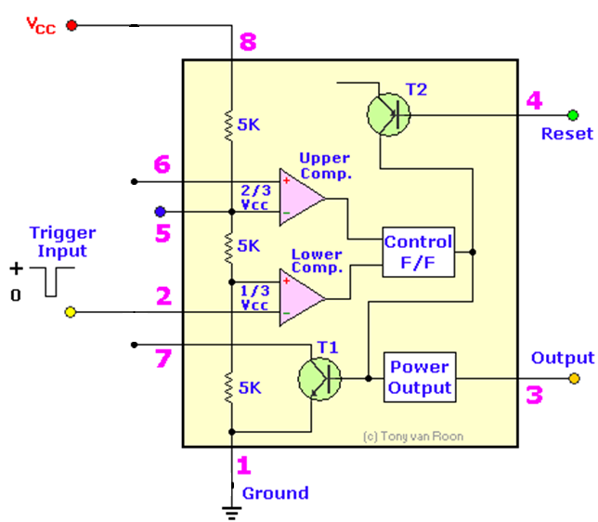
Inside the 555 Timer
+
Truth Table
Vref
S | R | Q | Q
0 | 0 | No Change
0 | 1 | 0 | 1
1 | 0 | 1 | 0
1 | 1 | X | X
Threshold
Control Voltage
R
Q
-
S
Q
Trigger
Discharge
Fig: Functional Diagram of 555 Timer

Slide 5
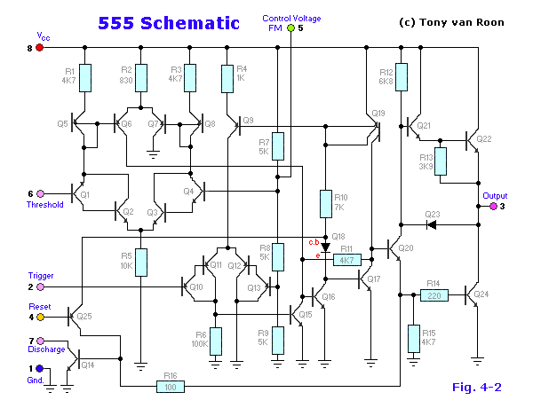

Slide 6
The 555 Timer is one of the best known IC’s.
The 555 is part of every experimenter's tool kit
Capable of creating a wide variety of circuits, including:
Oscillators with adjustable frequency and Duty Cycle
Monostable Multivibrators
Analog to digital Converters
Frequency Meters
Many other applications….
The clock on the Vulcan Board is generated by a 555 timer.

Slide 7
555 Timer Configurations
In this course we will use the 555 timer in 2 modes:
Astable
With some calculations, we can determine the values of the capacitor and the 2 resistors (Ra and Rb) for astable operations.
Monostable
We can determine the value of the resistor and the capacitor with a simple formula for one-shot operations.
There are many other configurations and applications for this device.

Slide 8
555 Layout
Ground
1
2
3
4
8
7
6
5
Vcc
Trigger
Discharge
Output
Threshold
Reset
Control
Also available:
556 (two-555’s in one DIP package)
555 in a “metal can” configuration
Vcc
Ground
8
Discharge
1
7
Trigger
Threshold
2
6
Output
5
Control
3
4
Reset

Slide 9
555 timer- Pin Description
Pin | Name | Purpose
1 | GND | Ground, low level (0 V)
2 | TRIG | OUT rises, and interval starts, when this input falls below 1/3 V_{CC}.
3 | OUT | This output is driven to approximately 1.7V below +V_{CC} or GND.
4 | RESET | A timing interval may be reset by driving this input to GND, but the timing does not begin again until RESET rises above approximately 0.7 volts. Overrides TRIG which overrides THR.
5 | CTRL | "Control" access to the internal voltage divider (by default, 2/3 V_{CC}).
6 | THR | The interval ends when the voltage at THR is greater than at CTRL.
7 | DIS | Open collector output; may discharge a capacitor between intervals. In phase with output.
8 | V+, V_{CC} | Positive supply voltage is usually between 3 and 15 V.

Slide 10
555 Timer
Description:
Contains 25 transistors, 2 diodes and 16 resistors
Maximum operating voltage 16V
Maximum output current 200mA
Best treated as a single component with required
input and output
INPUT
PROCESS
OUTPUT
If you input certain signals they will be processed / controlled in a certain manner and will produce a known output.

Slide 11
Oscillator Configuration
Externally, the 555 requires an RC circuit to create the time delays required for the time high and the time low.
Standard configuration requires
common capacitor
a resistor for the charge cycle
a resistor for the discharge cycle

Slide 12
General Configuration
Basic connections:
Ground
Vcc
Note: some 555 timers may function at voltages other than 5 volts.
Reset (active low)
Output
Ground
1
2
3
4
8
7
6
5
Vcc
Trigger
Discharge
Output
Threshold
Reset
Control

Slide 13
General Configuration
Specialized connections:
Trigger
monitors low voltage
Threshold
monitors high voltage
Discharge
path to ground, to discharge the capacitor
Control
specialized input
filtering
special applications
Ground
1
2
3
4
8
7
6
5
Vcc
Trigger
Discharge
Output
Threshold
Reset
Control

Slide 14
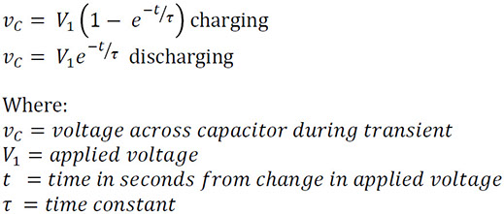

Slide 15
Astable Configuration #1 (“Standard” Configuration)
Vcc
Vcc
Vcc
Ra
1
2
3
4
8
7
6
5
Discharge
Ground
Rb
Output
Threshold
Reset
Trigger
Control
C

Slide 16
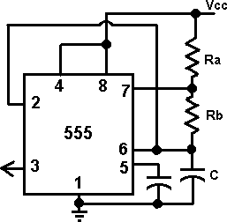
Astable
Calculated
Values
Note: Duty Cycle must be > 50%
Filter Cap
0.01μF

Slide 17
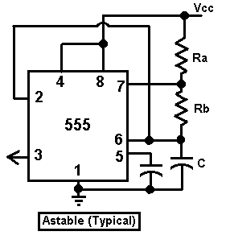
Astable Configuration #1 (“Standard” Configuration)
Minimum duty cycle > 50%

Slide 18
Calculations: Astable
Time High, Time Low Set
T_{H}
T_{L}
Notes:
The value 0.693 is a factor associated with the
charge/discharge cycle of the 555 timer.
Duty Cycle must be > 50%

Slide 19
Sample Calculation
Time High, Time Low Set
Design an oscillator with a frequency of 200Hz with a duty cycle of 78%.
Determine Period (T):
Determine T_{H} and T_{L}:

Slide 20
Sample Calculation
Time High, Time Low Set
Since there are 2 variables in the T_{L} equation, select C:
Determine R_{B} by using the T_{L} equation:
C=10μF

Slide 21
Sample Calculation
Time High, Time Low Set
Determine the value for R_{A}:

Slide 22
Calculations: Astable
Frequency, Duty Cycle Set
Notes:
The value 0.693 is a factor associated with the
charge/discharge cycle of the 555 timer.
Duty Cycle must be > 50%

Slide 23
Sample Design
Frequency, Duty Cycle Set
Build an oscillator using a 555 timer with a frequency of 72kHz at 75% D.C. Use a 100ρF capacitor.

Slide 24
Design Solution
Frequency, Duty Cycle Set
1- Determine the ratio of the resistors Ra and Rb:
2- Use the ratio in the frequency equation (substitution):

Slide 25
Design Solution
Frequency, Duty Cycle Set
3- Solve for Rb:
4-Solve for Ra:
5-Use standard values (optional step):
Ra=100kΩ
Rb=47kΩ

Slide 26
Design Solution
Frequency, Duty Cycle Set
6- Calculate actual frequency and DC:

Slide 27
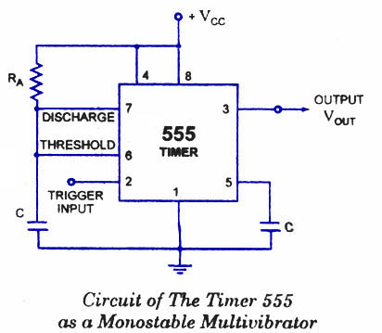
555 Timer as Monostable Multivibrator
Description:
In the standby state, FF holds transistor Q1 ON, thus clamping the external timing capacitor C to ground. The output remains at ground potential. i.e. Low.
As the trigger passes through VCC/3, the FF is set, i.e. Q bar=0, then the transistor Q1 OFF and the short circuit across the timing capacitor C is released. As Q bar is low , output goes HIGH.

Slide 28
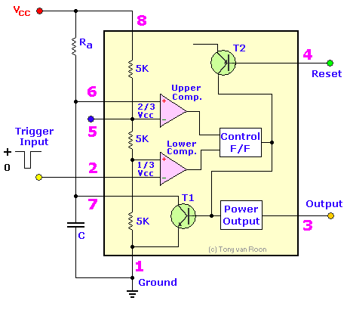
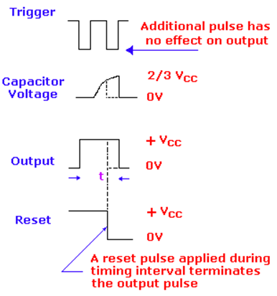
555 Timer as Monostable Multivibrator
Fig (a): Timer in Monostable Operation with Functional Diagram
Fig (b): Output wave Form of Monostable

Slide 29
555 Timer as Monostable Multivibrator
Fig (a): Timer in Monostable Operation with Functional Diagram
Fig (b): Output wave Form of Monostable

